Slide 1
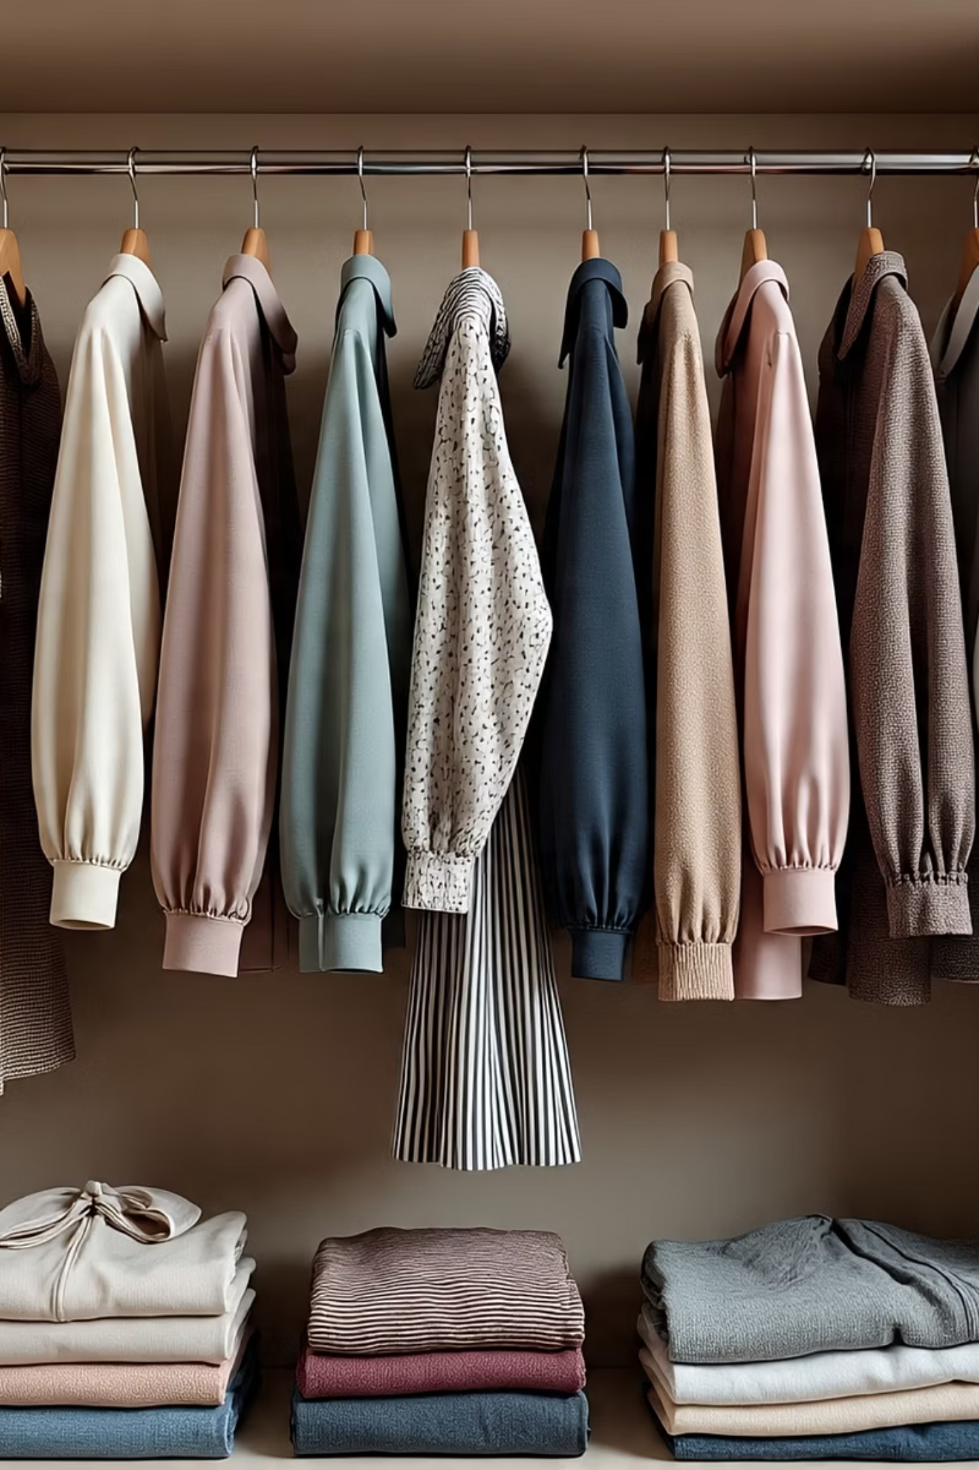
VastraSahayak
Your Personal Style Companion for Effortless Fashion.

Slide 2
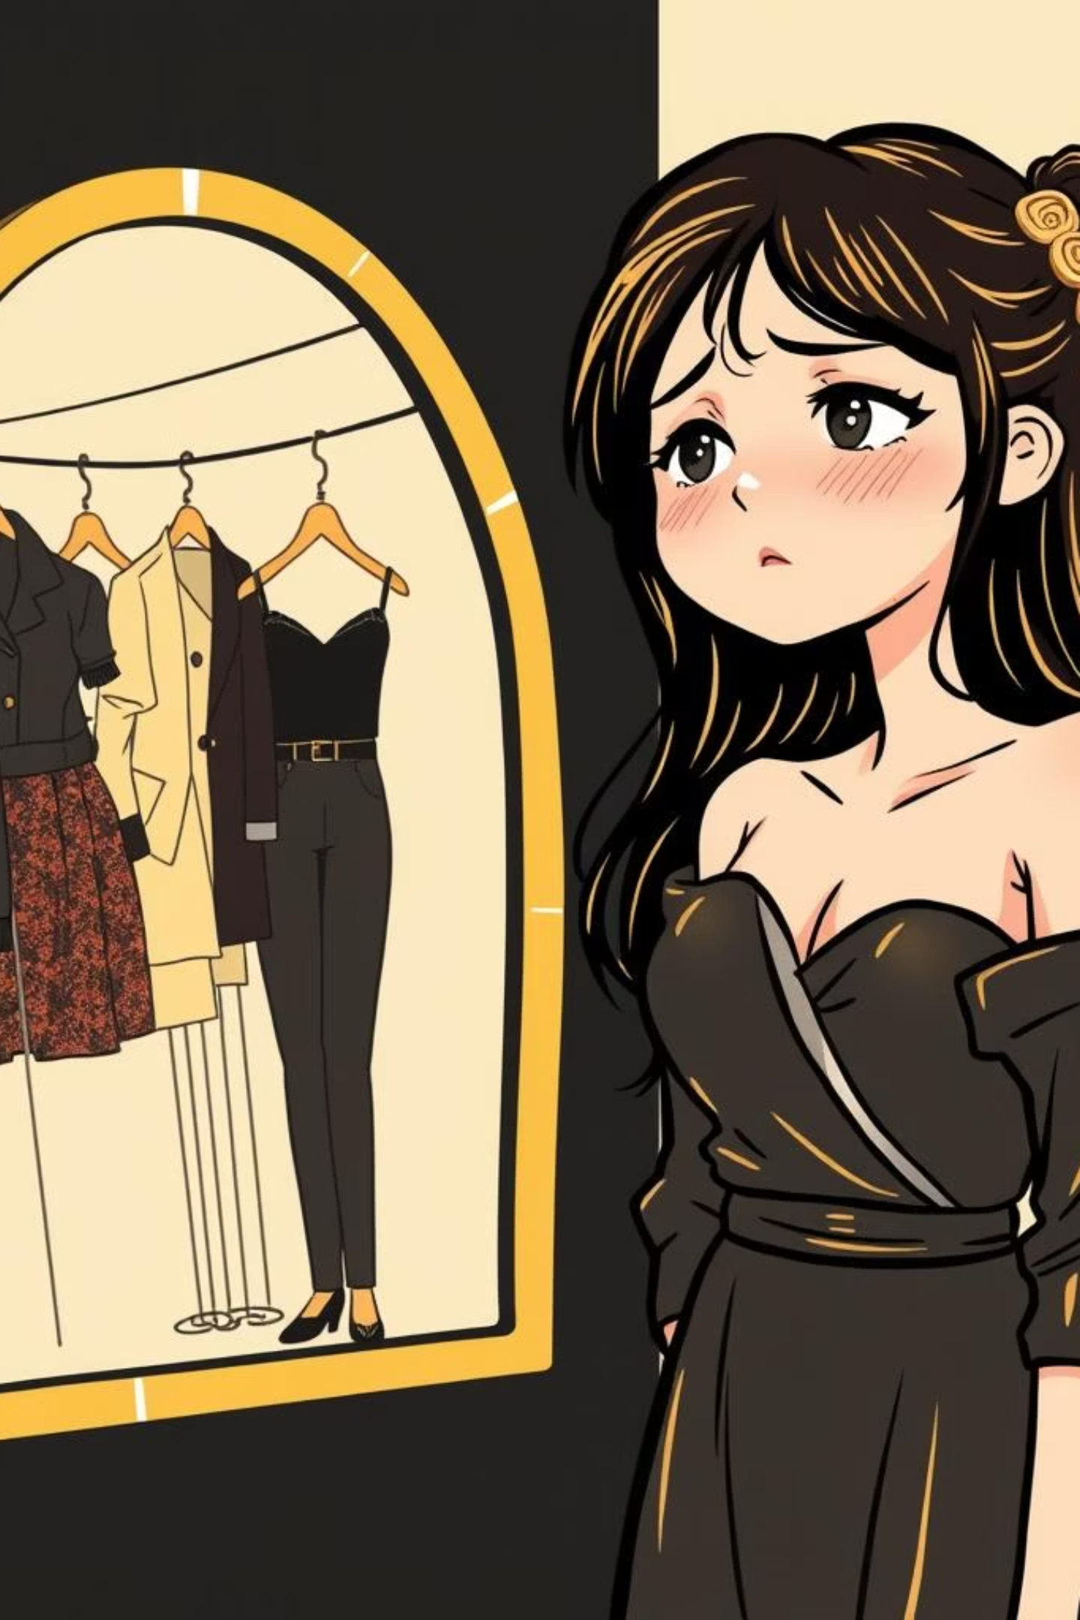
Ever Feel Overwhelmed?
Stressed About Your Body Type?
Navigating fashion can be confusing, especially when trying to find clothes that flatter your unique shape. We understand the struggle – the endless browsing, the fitting room despair, the feeling of "nothing looks good on me."

Slide 3

Unlocking Your Perfect Style
At VastraSahayak, we believe everyone deserves to feel confident and comfortable in their clothes. We've designed a revolutionary platform that simplifies fashion, allowing you to discover styles perfectly suited to your body type and preferences.
1
2
3
Personalized Body Analysis
Curated Recommendations
Color Theory Integration
Input your details and let our system determine your unique body type.
Receive clothing suggestions that flatter your figure and enhance your natural beauty.
Discover colors that complement your skin tone, inspired by Korean fashion principles.

Slide 4
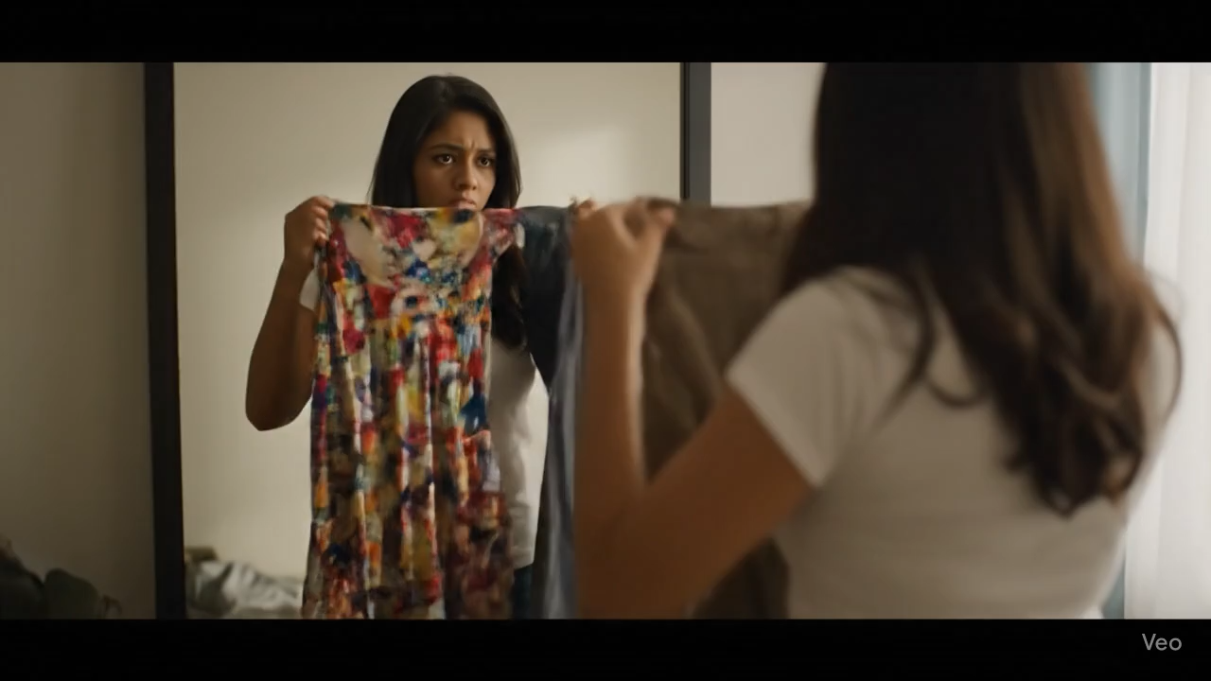
Demo Video of VastraSahayak Website:

Slide 5
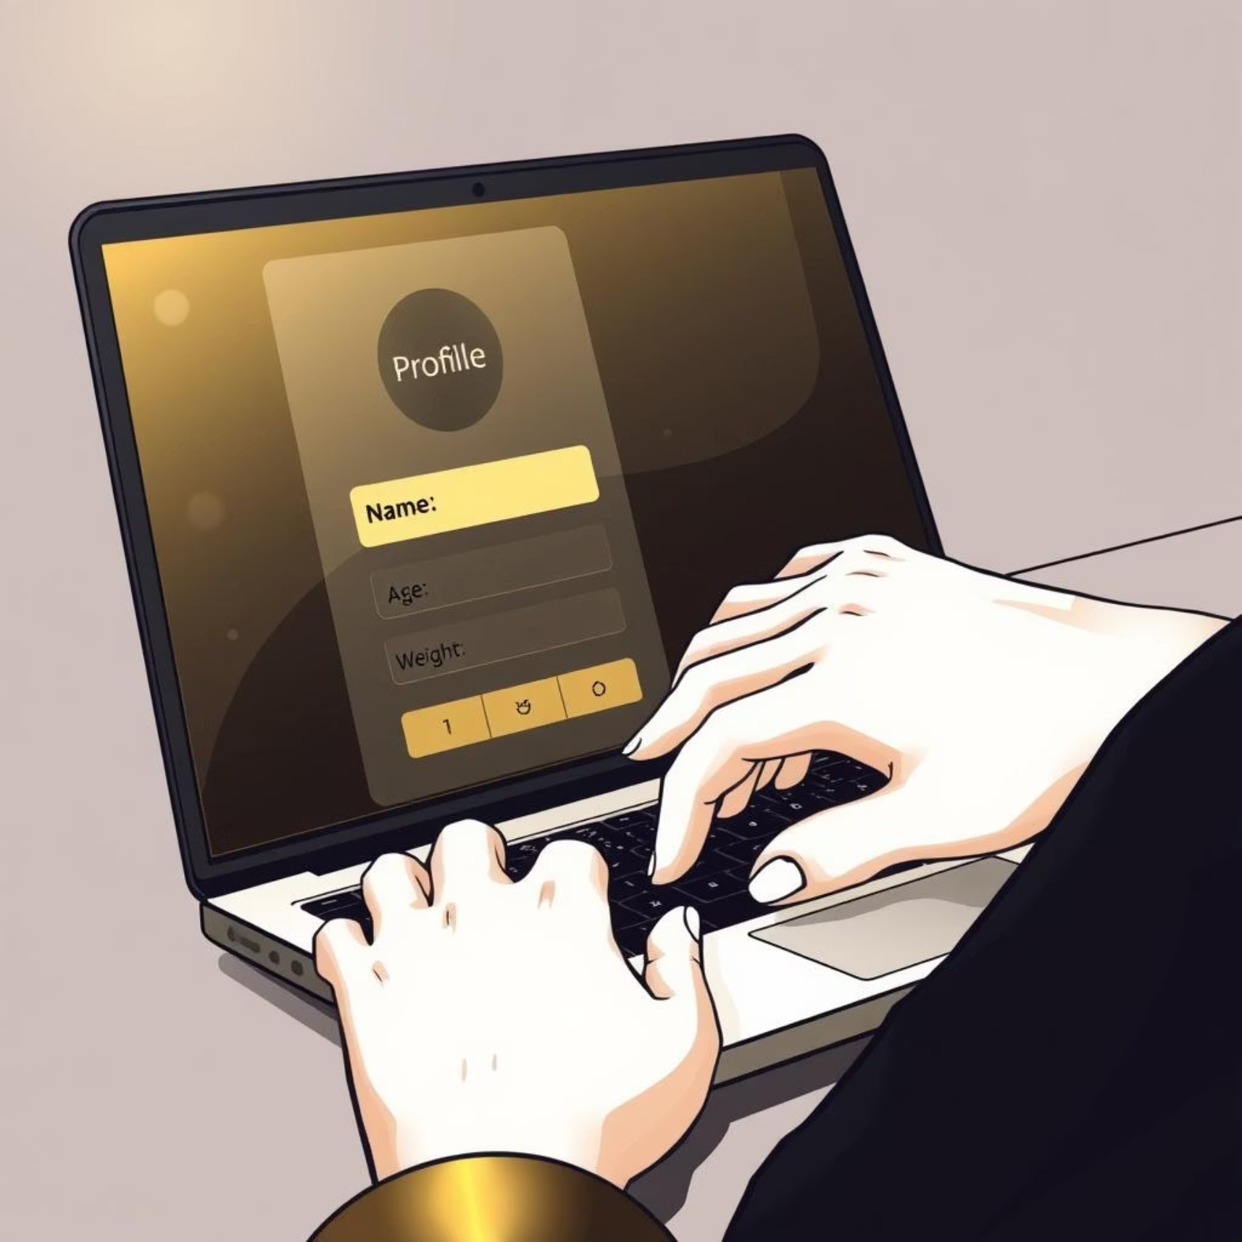
Your Personalized Profile
Getting started with VastraSahayak is simple and intuitive. Your profile is the key to unlocking truly personalized recommendations.
Input Your Details
Share essential information like your name, age, weight, and gender. These foundational details help us create a basic understanding of your unique profile.

Slide 6
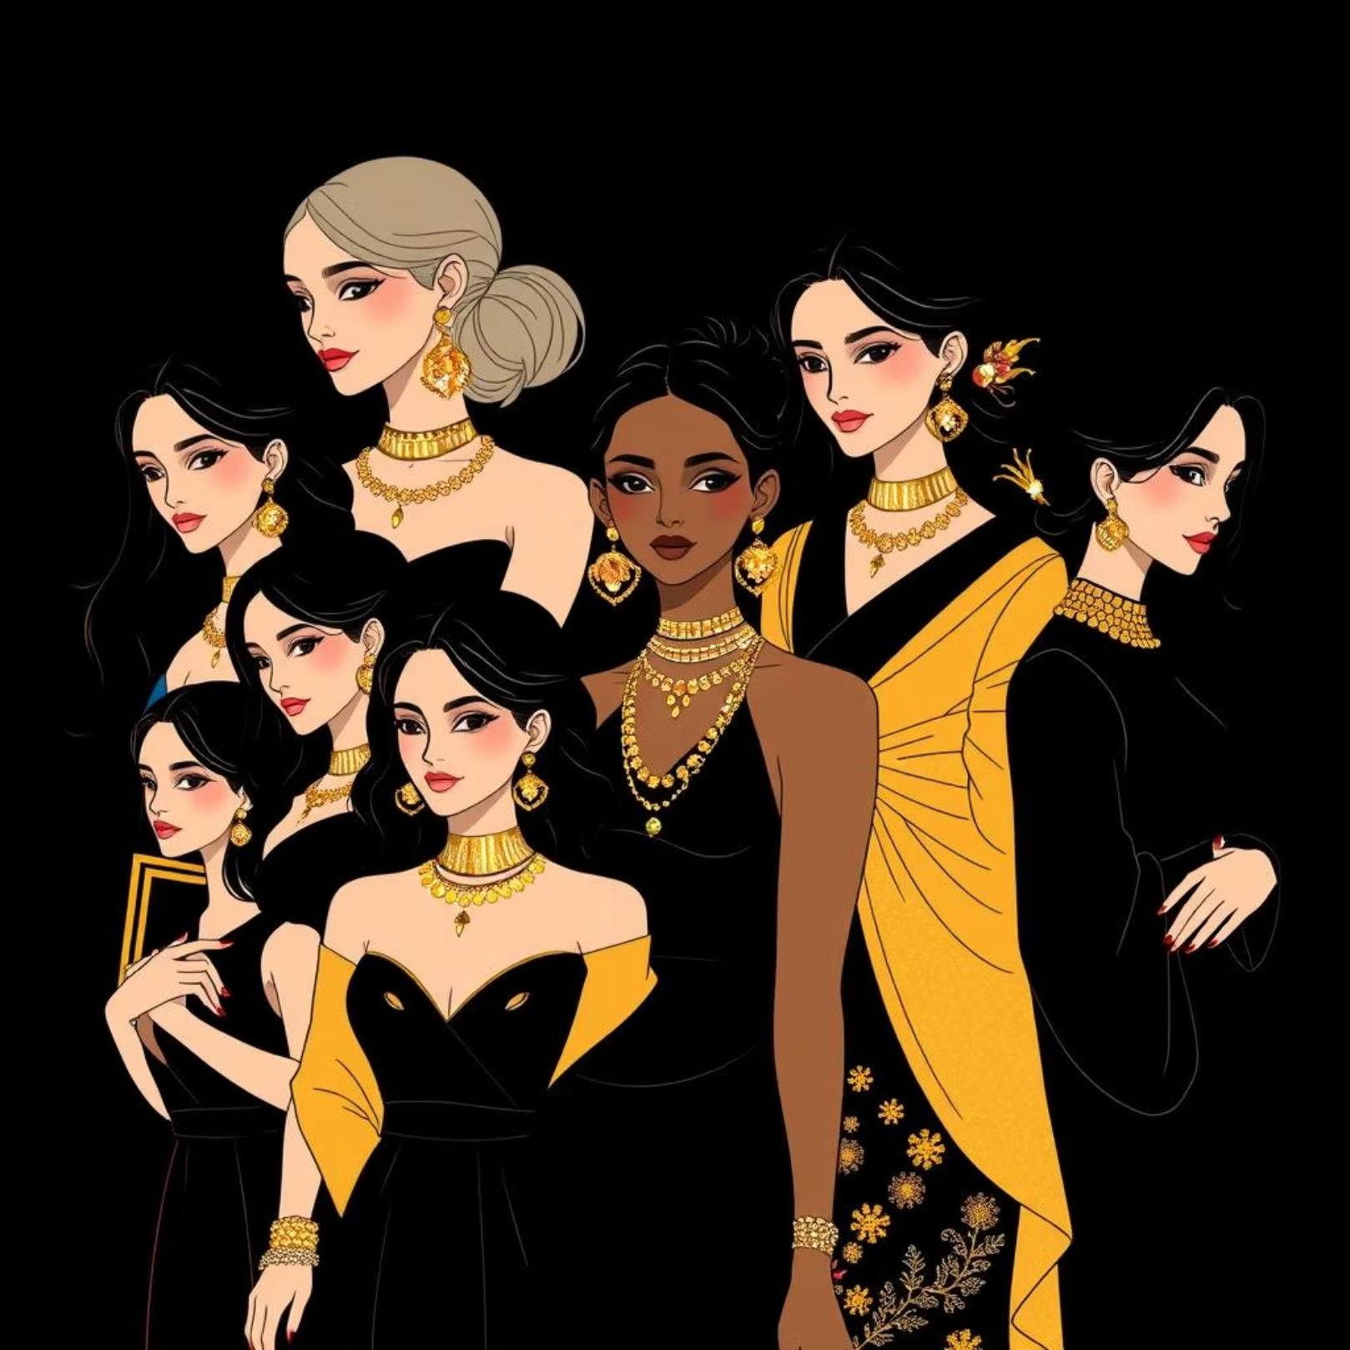
Understanding Your Body Type
Beyond basic demographics, VastraSahayak uses advanced analysis to determine your specific body type, ensuring recommendations are tailored to perfection.
Detailed Body Measurements:
Provide your height, shoulder width, bust, waist, and hip measurements. This allows our algorithm to accurately identify your body shape.
Why This Matters?
Knowing your body type empowers you to choose silhouettes that accentuate your best features and provide the most comfortable fit.

Slide 7



The Magic of Color Theory
Discover how colors can transform your look. VastraSahayak incorporates Korean-inspired color theory to help you choose hues that truly make you shine.
Skin Tone Analysis
Korean Color Principles
Glow with Confidence
Our system helps identify your unique skin undertone, whether it's warm, cool, or neutral.
Leveraging the subtle nuances of Korean color palettes to suggest what will best complement your complexion.
Select colors that brighten your face, enhance your features, and make your skin appear more radiant.

Slide 8
Beyond the Basics: Advanced Preferences
Your style journey is unique. VastraSahayak allows you to refine your preferences, ensuring recommendations align with your personal taste and lifestyle.
Style Aesthetic
1
Choose from categories like minimalist, bohemian, casual, formal, sporty, or vintage.
Occasion Focus
2
Tell us if you're looking for everyday wear, special event outfits, work attire, or vacation clothes.
Comfort Level
3
Prioritize comfort, trendiness, or a balance of both in your clothing choices.

Slide 9
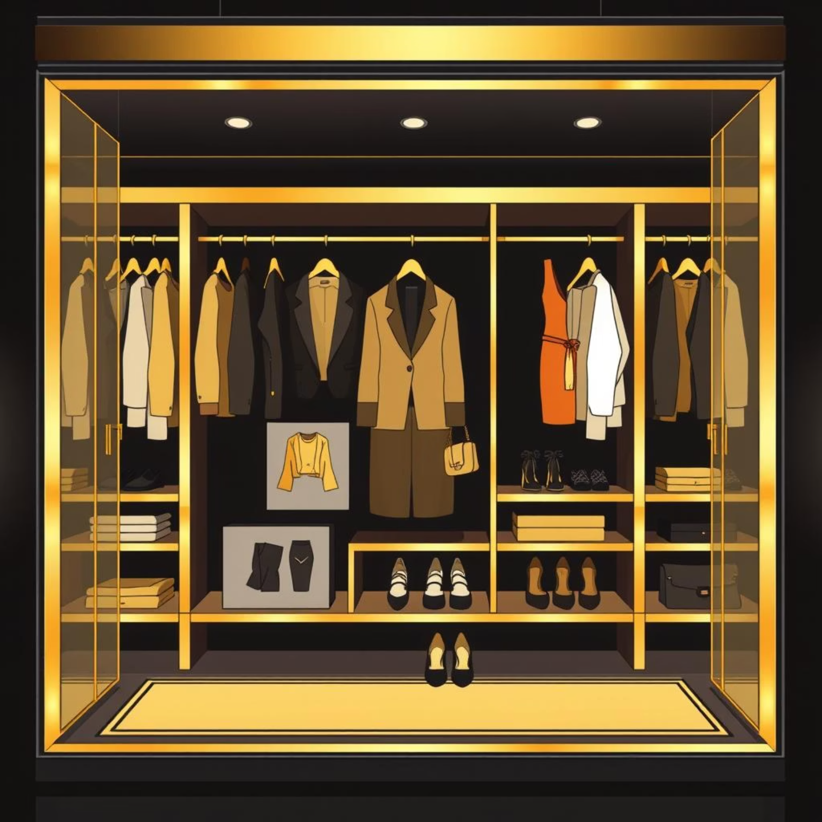
Your Personalized Wardrobe
Imagine a closet filled only with clothes that fit perfectly and make you feel incredible. VastraSahayak makes this a reality.
Wadrobe
→ Our intelligent algorithm combines your body type, color profile, and personal preferences to generate a tailored list of clothing items and outfit ideas. Say goodbye to guesswork and hello to a wardrobe that truly reflects you.

Slide 10
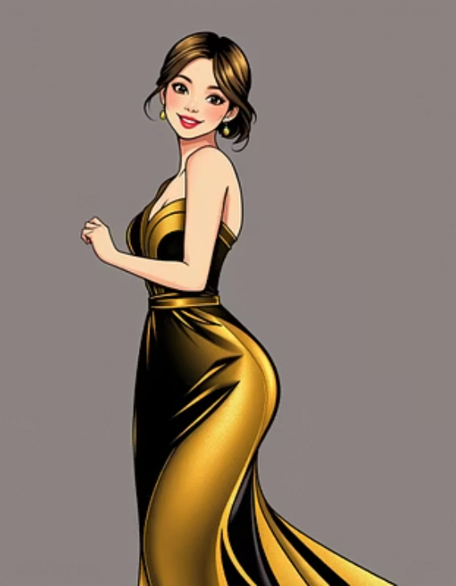

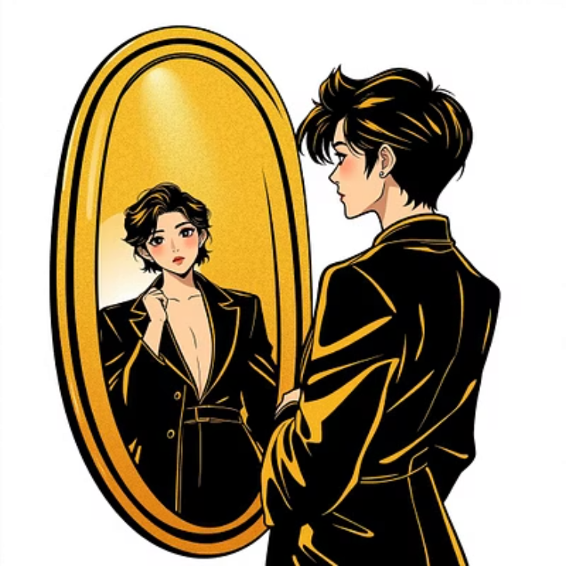
Start Your Style Journey Today!
Join the VastraSahayak community and transform the way you approach fashion.

Slide 11
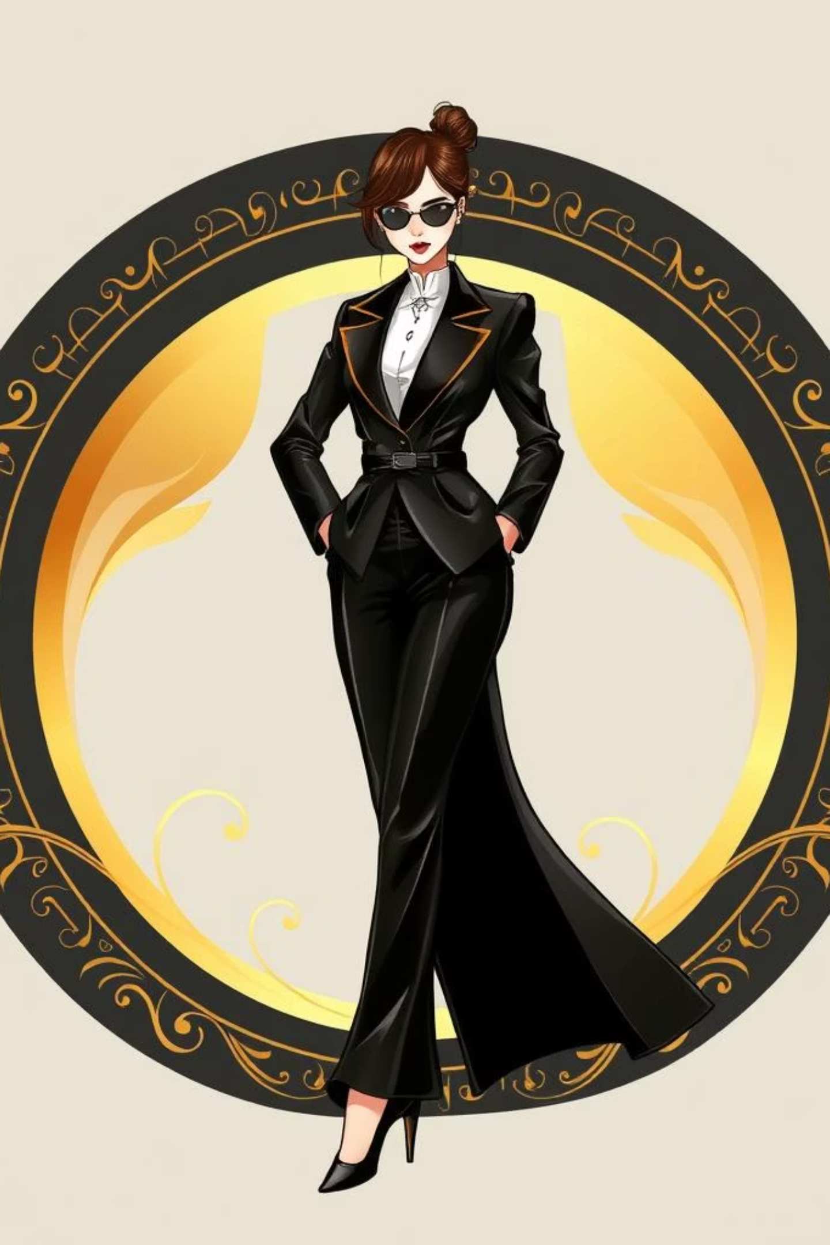
VastraSahayak:
Confidence, Style, Simplified.
Are you ready to embrace your unique style?
Visit our website and create your free profile today!

